Slide 1

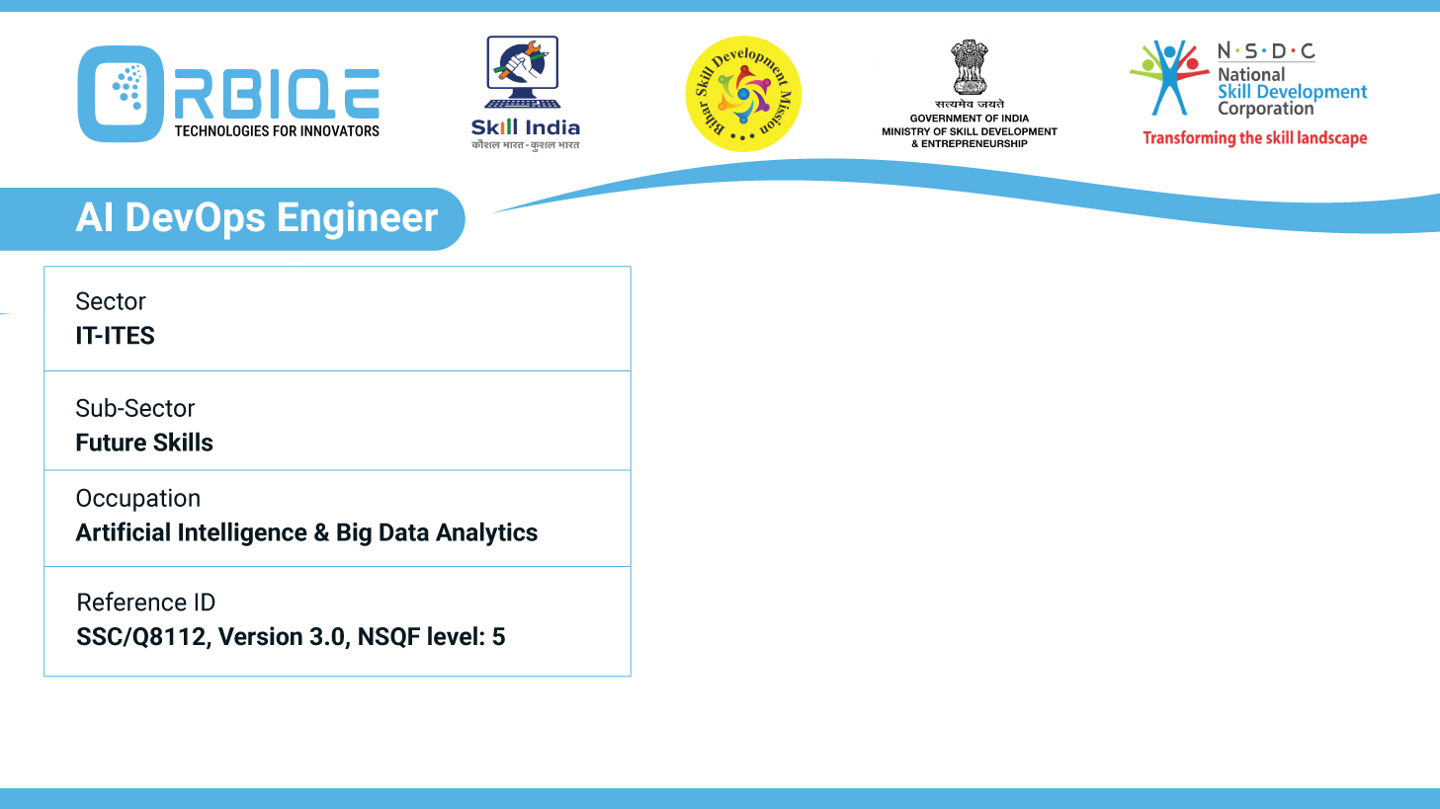
Name- Krishna Kant Dubey

Slide 2

Managing Dependencies and Versioning

Slide 3
Agenda
Dependency management tools
Implement version control practices

Slide 4
Dependency management tools
NPM
MAVEN
PIP

Slide 5
Implement version control practices

Slide 6
Thank You

